Slide 1


Policy Retrieval Integration
14 November 2013
Notes:
Guidewire training materials contain Guidewire proprietary information that is subject to confidentiality and non-disclosure agreements. You agree to use the information in this manual solely for the purpose of training to implement Guidewire software solutions. You also agree not to disclose the information in this manual to third parties or copy this manual without prior written consent from Guidewire. Guidewire training may be given only by Guidewire employees or certified Guidewire partners under the appropriate agreement with Guidewire.
Policy Retrieval Integration - <number>

Slide 2
Lesson objectives
By the end of this lesson, you should be able to:
  List the high-level steps of policy retrieval
  List the primary entities in the policy graph
  Identify the typelists in the Line of Business model that policy retrieval must map to
  Implement a basic policy retrieval integration point
  This lesson uses the notes section for additional explanation and information.
  To view the notes in PowerPoint, choose View→Normal or View→Notes Page.
  If you choose to print the notes for the lesson, be sure to select “Print hidden slides.”
Notes:
Policy Retrieval Integration - <number>

Slide 3
Lesson outline
Policy retrieval overview
The policy graph
The Line of Business model
Policy retrieval example
Notes:
Policy Retrieval Integration - <number>

Slide 4


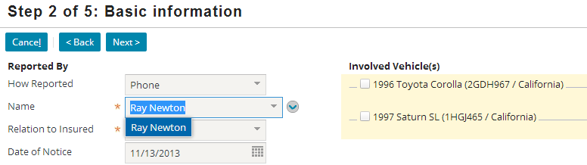
Policy retrieval
Policy retrieval involves retrieving a full policy associated with the policy summary object selected by the user
Notes:
Policy retrieval typically occurs between the first and second steps of the New Claim wizard. It consist of retrieving a full copy of the policy selected on step 1 of the New Claim wizard and then mapping the data in that policy to the ClaimCenter data model. For example, as shown above, the adjuster selects the summary for policy 54-123456 in Step 1. Between steps 1 and 2, the entire policy is retrieved and loaded into ClaimCenter. This includes the insured's name, address, primary phone number, and the vehicles listed on the policy.
Policy retrieval should always return exactly one policy.
Policy Retrieval Integration - <number>

Slide 5
At a high level, policy retrieval is simple
There are only two basic steps to policy retrieval:
  Query the PAS for the policy that matches the selected policy summary
  Map the policy data into a set of related ClaimCenter objects
Notes:
Policy Retrieval Integration - <number>

Slide 6
In execution, policy retrieval is highly complex
The amount of data received from the external system is larger than virtually any other integration point
ClaimCenter must create a large number of related objects to capture the policy data
Mapping PAS data to ClaimCenter objects is complex:
  Fields do not always map one-to-one
  The data itself may need to be transformed
There are often numerous and complex "edge cases" (such as variations in policy structure for policies issued in 2002)
Because each policy system is essentially unique, there are usually no "accelerators" or "starter code" that can be used to accomplish the initial work
Notes:
Policy Retrieval Integration - <number>

Slide 7
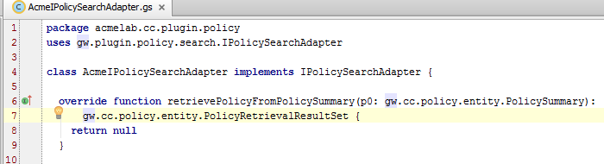
The IPolicySearchAdapter interface
Includes the retrievePolicyFromPolicySummary() method, which makes use of these entities:
  PolicySummary
  PolicyRetrievalResultSet
Notes:
The interface for the policy search-and-retrieval plugin is:
Gosu: gw.plugin.policy.search.IPolicySearchAdapter
Java: com.guidewire.cc.plugin.policy.search.IPolicySearchAdapter
The IPolicySearchAdapter has four methods:
searchPolicies(), which is used for policy search and is discussed in the "Policy Search Integration" lesson.
retrievePolicyFromPolicySummary(), which is used for policy retrieval and is discussed in this lesson.
retrievePolicyFromPolicy(), which was a method formerly used to implement policy refresh. Implementation of this method is no longer recommended, Instead, one should configure the gw.plugin.policy.refresh.PolicyRefreshConfigurationBase class as described in the Policy Refresh lessons.
retrievePolicySummaryFromPolicy(), which is used by policy refresh for the Commercial Property and Commercial Auto lines of business. When a claim is initially created for these lines of business, the adjuster is shown a list of the properties/vehicles on the policy summary (of which there could be tens or hundreds) and allowed to select the subset of properties/vehicles relevant to the claim. Only the selected subset are copied over when the policy is retrieved. If the policy is later refreshed, the adjuster must once again have a chance to select the subset of relevant properties/vehicles from the policy summary, which means the policy summary must be re-retrieved before the policy itself is re-retrieved. The re-retrieval of the policy summary is executed by this method.
Policy Retrieval Integration - <number>

Slide 8
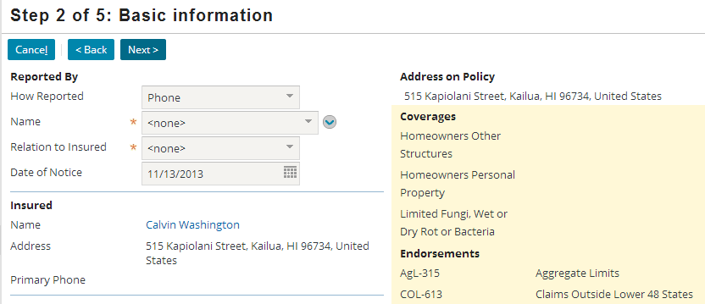
PolicyRetrievalResultSet
PolicyRetrievalResultSet is an object that:
  Verifies a single policy was retrieved
  Has a foreign key to the retrieved policy, as constructed by the retrievePolicyFromPolicySummary() method
Unique!
Notes:
Policy Retrieval Integration - <number>

Slide 9
Data structures related to policy retrieval
The policy graph, which is the graph of ClaimCenter objects that store information about the policy
The Line of Business (LOB) model, which is a set of related typelists that define loss types, policy types, and coverage types, and how they relate to one another
Policy
Notes:
Policy Retrieval Integration - <number>

Slide 10
Lesson outline
Policy retrieval overview
The policy graph
The Line of Business model
Policy retrieval example
Notes:
Policy Retrieval Integration - <number>

Slide 11
Conceptual structure of a "P&C" policy
policy
coverage
terms
liability
coverages
risk
units
property
coverages
coverage
terms
(limit:
$10000)
liability -
vehicle dmg
collision
(deduct: $500)
compreh.
(deduct: $500)
policy
locations
endorsements
Notes:
There is no codified structure for property and casualty ("P&C") policies that all insurance carriers adhere to. Nevertheless, there is an "average structure" that at least most carriers adhere to most of the time. This structure includes the following elements. Keep in mind that this is not an exhaustive list of the types of information that can be found on a property and casualty policy, but rather is the minimal set of information needed for a basic understanding.
A policy is a contract between the carrier and the insured in which the carrier promises to cover the insured for specific types of losses. A policy can be thought of as a collection of coverages, or types of loss, that is or can be listed on a policy which the carrier will cover. There are two basic types of coverages: liability coverages and property coverages.
A liability coverage covers the insured's liability when damage is done to a third party. The coverage exists to provide financial remuneration if a third party suffers a loss for which the insured is liable. (For example, an auto policy's "liability - vehicle damage" coverage covers damage done to a third party's car for which the insured is responsible.)
A property coverage covers tangible assets "belonging to" the insured, such as a vehicle, home, or in the case of workers' comp, a class of workers. The coverage exists to repair or replace the asset if it is lost, damaged, or otherwise rendered unusable. (For example, an auto policy's collision coverage covers the car in the event that it is damaged due to a collision.)
A risk unit is something (other than the insured) that may be exposed to risks and is protected by the policy. In most cases, they are tangible "covered items", such as a vehicles and buildings, or, in the case of workers' comp policies, protected groups of workers.
A coverage term (also known as a "cov term") is a value that further limits or defines the coverage. Deductibles and limits are the most common type of coverage terms. A coverage may have zero to many coverage terms.
(continued)
Policy Retrieval Integration - <number>

Slide 12
(Noted Only Slide)
Notes:
An endorsement is a physical document detailing some aspect of the policy. All of the endorsements collectively document the nature of the policy contract.
A policy location is a physical location which may be referenced on a policy, such as where a covered vehicle is garaged, where a covered business is located, or where a group of covered employees do their work.
Policy Retrieval Integration - <number>

Slide 13
The policy graph
Policy
The policy graph is the set of data model entities that store information about the policy
  It can be thought of as the "policy data model"
  Instances of these entities are created during policy retrieval
During the implementation, developers must determine how to map PAS data into the policy graph
Notes:
Keep in mind that the policy graph is a graph, and not a strict hierarchy. Instances in the graph are not necessarily uniquely owned by one and only one parent. It is often possible for to traverse from one instance in the policy graph to another in multiple ways.
There is no industry standard for how policies are captured in a data model.
Policy Retrieval Integration - <number>

Slide 14
The Policy entity
Claim
Policy
Policy is the root of the policy graph
Certain claim-relevant attributes may be stored at the policy level, including:
  Policy type (such as personal auto)
  Effective and expiration date
  Account number (number of account associated with policy)
Notes:
There is a one-to-one relationship between Claim and Policy. This is because every claim has its own snapshot of the policy. Even if two claims are filed against the same PAS policy, each claim will have its own policy instance in ClaimCenter.
Policy Retrieval Integration - <number>

Slide 15
The RiskUnit entity
Claim
Policy
RiskUnit
Vehicle
Building
Class
Code
The RiskUnit entity captures information about risk units
  Details about the item being covered is in foreign key entity
    Example: Vehicle, Building, or ClassCode
  Supertype entity
    Subtype examples: VehicleRU, BuildingRU, and WCCovEmpRU
Notes:
In the insurance industry, a risk unit may also be known as a "coverable" or an "exposure".
The Policy entity has an array of RiskUnits.
The RiskUnit entity is subtyped. The primary subtypes are LocationBasedRU (for physical, non-mobile risk units, such as buildings), VehicleRU (for vehicles), and TripRU (for individual legs of a trip).
The RiskUnit entity also includes foreign keys to:
Building (to capture building information for the LocationBasedRU subtype)
Vehicle (to capture vehicle information for the VehicleRU subtype)
ClassCode (to capture employment class codes for workers' comp policies)
Keep in mind that risk units are used only in the mapping of property coverages. For liability coverages, the thing being covered is the policy holder. Therefore, liability coverages map directly to the policy and are not associated to any instances of RiskUnit.
Policy Retrieval Integration - <number>

Slide 16
The Coverage entity
Claim
Policy
RiskUnit
Coverage
Vehicle
Building
Class
Code
The Coverage entity captures coverage information
Coverage has two subtypes:
  RUCoverage, which stores property coverages associated with a specific risk unit (such as collision coverage for a specific vehicle)
  PolicyCoverage, which stores liabilty coverages associated with the policy itself (such as medical liability coverage)
Notes:
The Coverage entity captures coverage information.
Both the Policy and RiskUnit entities have arrays of coverages called "Coverages". The Policy.Coverages array stores liability coverages (instances of the PolicyCoverage subtype of Coverage). The RiskUnit.Coverages array stores property coverages (instances of the RUCoverage subtype of Coverage).
The Coverage entity also has three fields for storing coverage term information: Deductible, ExposureLimit, and IncidentLimit. However, Guidewire recommends that these fields not be used in a production system. They lack the flexibility needed to capture the various types of coverage terms needed for multiple lines of business. The best practice is to store coverage term information in separate instances of the CovTerm entity.
Policy Retrieval Integration - <number>

Slide 17
The CovTerm entity
Claim
Policy
RiskUnit
Coverage
Vehicle
Building
Class
Code
CovTerm
The CovTerm entity is a supertype entity that stores information about coverage terms
  The subtypes include ClassificationCovTerm, FinancialCovTerm, and NumericCovTerm
  The CovTermPattern typekey identifies the type of coverage term (such as a limit or deductible)
Notes:
Recall that a coverage term is a "value that further limits or defines the coverage."
In some cases, the value is a financial amount (such as a Collision coverage with a deductible set to $1000). In this case, the coverage term would be stored in instance of FinancialCovTerm. This subtype has a FinancialAmount field used for storing monetary values.
In some cases, the value is an integer amount (such as a Towing coverage with a coverage term that specifies the number of miles for which towing is covered). In this case, the coverage term would be stored in instance of NumericCovTerm. This subtype has NumericValue and Units fields used for storing non-monetary numeric values.
In some cases, the value is a non-numeric amount (such as a Comprehensive coverage with a "no deductible for glass" option that is set to either "yes" or "no"). In this case, the coverage term would be stored in instance of ClassificationCovTerm. This subtype has Code and Description fields used for storing non-numeric values.
Policy Retrieval Integration - <number>

Slide 18
The PolicyLocation entity
Policy
Location
Address
Claim
Policy
RiskUnit
Coverage
Vehicle
Building
Class
Code
CovTerm
The PolicyLocation entity stores physical location which may be referenced on a policy
Each location has a foreign key to an address
Each location is referenced by other entities as needed, such as Vehicle and Building
Notes:
The Policy entity has an array of PolicyLocations. Each PolicyLocation maps to a single Address.
A policy location is usually tracked separately from the address. This is because a policy location could have multiple buildings (such as a house and a tool shed) and yet a single address.
The PolicyLocation entity also has the following arrays:
Buildings (an array of Building entity instances)
HighValueItems (an array of PropertyItem entity instances)
Lienholders(an array of PropertyOwner entity instances)
Policy Retrieval Integration - <number>

Slide 19
The Endorsement entity
Policy
Location
Address
Claim
Policy
RiskUnit
Coverage
Vehicle
Building
Class
Code
Endorse-
ment
CovTerm
The Endorsement entity stores information about whether or not a given endorsement is on a given policy
  This can affect claims processing because the presence or absence of an endorsement could establish, limit, or invalidate protection for a given type of loss
Notes:
The Endorsement entity is not used to store the contents of a given endorsement, but simply whether or not the endorsement is associated with the policy. Consequently, the Endorsement entity tracks only minimal information, such as the Endorsement form number and description.
Be aware that some carriers also use the term "policy endorsement" to refer to a change to a policy (such as adding a vehicle to an existing personal auto policy).
Policy Retrieval Integration - <number>

Slide 20
Additional information
Policy
Location
Address
Claim
Policy
RiskUnit
Coverage
Vehicle
Building
Class
Code
Endorse-
ment
CovTerm
ClaimCenter may need additional data to verify coverage existed and/or was applicable to the loss, such as:
  Whether a driver had a citation prior to the policy being issued
  Whether a business offered safety courses to prevent injuries
This information may exist on PAS entities that don't readily map to one of the entities above
Notes:
In Guidewire's PolicyCenter application:
Qualifying information (such as whether a given driver had citations) is stored in question sets.
Modifier information (which can modify the quote for a portion of the policy and may be based on information such as whether a business offered safety courses) is stored in modifiers.
In general, information about the policy premium (the total cost of the policy), how the premium is calculated, and the billing history is not relevant to the claims process. However, some policy costs may be calculated based on information provided by the insured, such as whether a group of workers had received accident prevention training or whether a driver had prior citations. This information may become relevant to the claims process if it needs to be verified or further documented by the adjuster.
If there is information in the PAS policy that is relevant to claims adjusting but does not readily map to one of the entities above, then it is up to the integration team to determine where and how to store the information. For example, qualifying information (such as whether a given driver had citations) could be stored in custom fields on the Contact entity, or custom fields on the Policy entity, or in a new, custom entity called QualifyingInfo. The optimal solution will depend on how the data maps to the other policy data and how it will be used during claims adjusting.
Policy Retrieval Integration - <number>

Slide 21
Policy retrieval and Xml
Policy
LegacyPolicy
Graph.xml
Most policy retrieval implementations format the policy graph data as XML
  This is a convenient option as it simplifies the sending and interpreting of a large graph of data
Guidewire's XmlElement class lets you easily parse and manipulate XML
Notes:
The XmlElement class is discussed in detail in the "XML and Gosu" lesson.
The homeowners policy retrieval example shown at the end of this lesson makes use of the XmlElement class.
Policy Retrieval Integration - <number>

Slide 22
Lesson outline
Policy retrieval overview
The policy graph
The Line of Business model
Policy retrieval example
Notes:
Policy Retrieval Integration - <number>

Slide 23
The Line of Business model
The Line of Business (LOB) model is a set of six hierarchical typelists that define the structure of the policies and coverages offered by a carrier
  Configuration developers maintain the LOB model typelists
  Integration developers implement policy retrieval so that PAS data maps correctly to the LOB model's policy types
  and coverage types
Loss Type:
Property
Policy Type:
Homeowners
Coverage Type: earthquake coverage
Exposure Type:
property (damage)
Notes:
The Line of Business model impacts:
How claim reporting is done
Which coverages are displayed for claims associated with a given type of policy
Which user interface elements are used to capture information for a given exposure
The six typelists are LossType, LOBCode, PolicyType, CoverageType, CoverageSubtype, and ExposureType.
The ClaimCenter base application has several pre-configured business lines in the LOB model. When adding a new claim or exposure, the preconfigured business lines are available. Based on the line of business presented or selected, you will have different options.
Policy Retrieval Integration - <number>

Slide 24
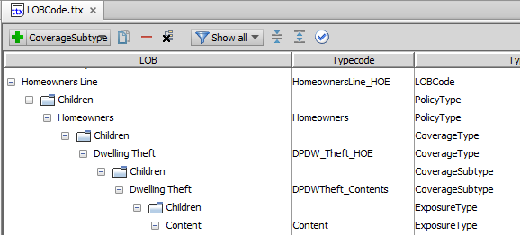
The LoB model in Studio
LoB typelists appear in config → extensions → typelist
  Contain information about their parent and child nodes
  You can drill down (or up)

Slide 25
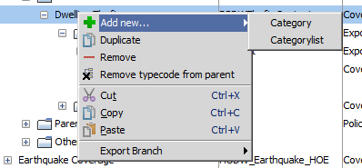
Editing the LoB model
Context-sensitive right-click menus allow you to add and delete items in the LoB typelists
Notes:
Note: In ClaimCenter 8.0.0, there is a known bug such that when you "Remove typecode from parent" it also removes from grandparent. This will be fixed in 8.0.1.
Policy Retrieval Integration - <number>

Slide 26
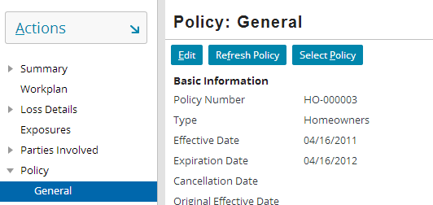
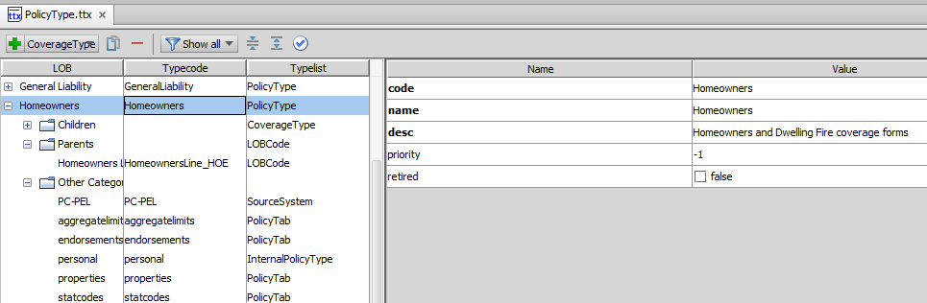
Policy types: Example
Notes:
During policy retrieval, every policy must have a policy type that corresponds to one of the values in the PolicyType typelist. In the example above, the policy's type is "Homeowners".
Policy Retrieval Integration - <number>

Slide 27
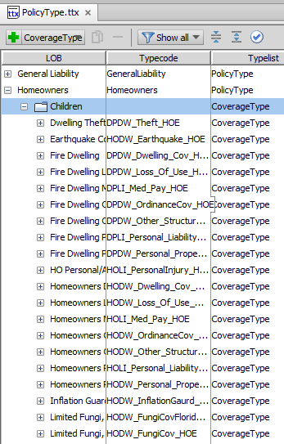
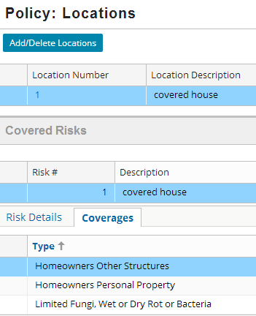
Coverage types: Examples
Notes:
During policy retrieval, every coverage must have a coverage type that corresponds to one of the values in the CoverageType typelist and that is associated to the policy's PolicyType.
PolicyType to CoverageType is M:M (many-to-many). However, in the base application, most coverage types belong to a single policy type.
A type of policy can include many coverages. For example, Personal Auto includes Collision, Comprehensive, and Medical Payments.
Theoretically, a coverage may be available on more than one policy type. For example, the same type of Collision coverage could be offered on both personal and commercial auto policy types, and therefore could be referenced by both the Personal Auto and Commercial Auto policy types. (In the ClaimCenter base application, each auto policy type has its own collision coverage type.)
Policy Retrieval Integration - <number>

Slide 28


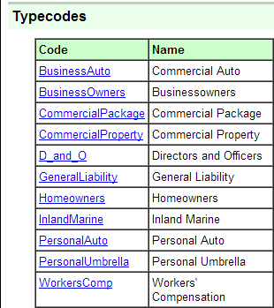

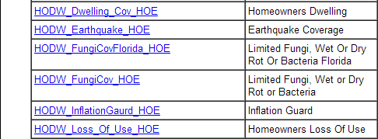
Policy and coverage types in the Data Dictionary
Notes:
As is the case with all typelists, policy types and coverage types also appear in the Data Dictionary.
Policy Retrieval Integration - <number>

Slide 29
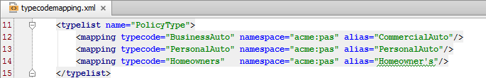
Policy retrieval and the typecode mapper
PolicyType
BusinessAuto
PersonalAuto
Homeowners
PolicyType
CommercialAuto
PersonalAuto
Homeowner's
PAS
Guidewire's typecode mapper is a utility that translates Guidewire typecodes into external application values and vice versa
  This is useful for policy retrieval when managing the large number of policy and coverage typecodes
Notes:
In the example above, the code for the personal auto policy type is the same in both systems. However, the code for commercial auto is different, and the code for homeowners is spelled slightly differently. (The PAS has an apostrophe, whereas ClaimCenter does not.)
Typecode mapping is discussed in detail in the "Typecode Mapper" lesson.
The homeowners policy retrieval example shown at the end of this lesson makes use of the typecode mapper.
Policy Retrieval Integration - <number>

Slide 30
Lesson outline
Policy retrieval overview
The policy graph
The Line of Business model
Policy retrieval example
Notes:
Policy Retrieval Integration - <number>

Slide 31
Retrieval example for homeowners
The sample implementation makes extensive use of Gosu code that manipulates XML
  When necessary, the code is explained in the notes
  However, the specifics of the XML code is less important
  What is more important is the objects that need to be created and the data that must be mapped during policy retrieval
Notes:
The Homeowners line of business as modeled in ExternalApp is unrealistically simple. Furthermore, the code that executes policy retrieval makes several assumptions that could not be made for any real PAS. Keep in mind that the example has been simplified to keep the discussion to a reasonable length and to help students understand the high-level issues involved in policy retrieval. Any actual policy retrieval implementation that works against a real PAS will be significantly more complex.
You can make this example function in ClaimCenter. To do this, you must:
Load the AcmeIPolicySearchAdapter files into ClaimCenter. (Information about this is included in the lab.)
Have ExternalApp running.
The lesson also includes a "SampleHomeownersPolicy.xml" file. You may want to refer to this file to help understand how the Gosu code transforms the XML into ClaimCenter data.
Policy Retrieval Integration - <number>

Slide 32
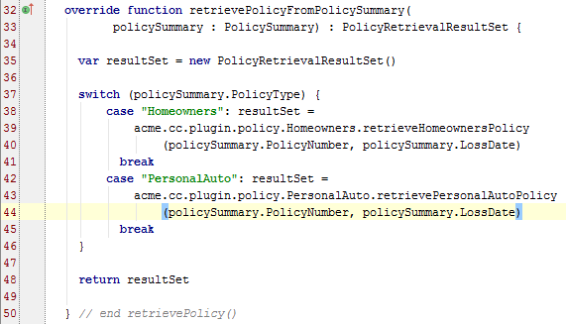
Calling LOB-specific search method
The policy retrieval example uses separate methods based on the policy's line of business
Notes:
Policy retrieval is almost always significantly different for each line of business. Each line may have different types of risk units and significantly different data models in the PAS. In some cases, different lines of businesses are managed by different PASs. Consequently, dividing policy retrieval logic by line of business is often a practical approach.
Policy Retrieval Integration - <number>

Slide 33
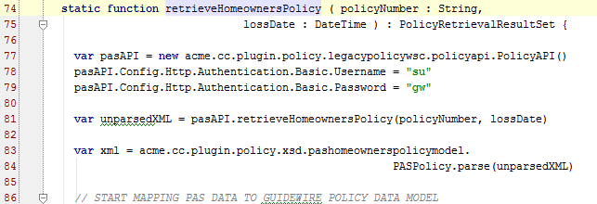
Query PAS for policy data
Policy
(policy data)
Policy
Admin
System
Notes:
Within the context of XML, an XSD (XML Schema Document) is a file that describes the legal structure for elements in one or more XML documents. You can load an XSD into ClaimCenter, which gives ClaimCenter the ability to parse any XML based on that XSD and work with its elements as native Gosu types.
In the ExternalApp homeowners example:
The retrieveHomeownersPolicy API returns the policy graph as XML. On line 81, this XML is stored in an object named "unparsedXML".
There is an XSD for this XML, called "pashomeownerspolicymodel", that has been loaded into ClaimCenter in the acme.cc.plugin.policy.xsd package. On line 83, this XSD is used to parse the XML received from the API. The parsed XML is stored in an object named "xml".
Policy Retrieval Integration - <number>

Slide 34
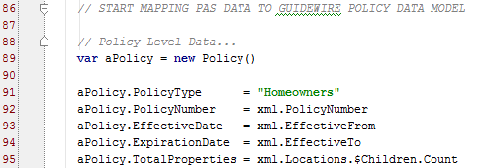
Mapping policy entity data
Policy
Location
Address
Policy
RiskUnit
Coverage
Vehicle
Building
Class
Code
(policy data)
Endorse-
ment
CovTerm
Notes:
Initially, a Policy object must be created, and the policy-level data mapped to it.
Because the codes for the Homeowners policy type differ between ClaimCenter and the PAS, line 92 sets the policy type to the ClaimCenter code.
XML Notes
When ClaimCenter uses an XSD to parse XML, the XML elements defined in the XSD are converted into Guidewire types. This gives the developer the ability to refer to specific XML elements in Gosu by name. For example, the pashomeownerspolicymodel XSD defines the following structure:
<PASPolicy>
<PolicyType>...</PolicyType>
<PolicyNumber>...</PolicyNumber>
<EffectiveFrom>...</EffectiveFrom>
<EffectiveTo>...</EffectiveTo>
<Locations>...</Locations>
...
</PASPolicy>
When XML has been parsed using this XSD and loaded into an object, you can reference the value of each element by using the syntax parsedXmlObject.elementName. For example, "xml.PolicyNumber" (as seen in line 93) references the root element's <PolicyNumber/> element.
(continued...)
Policy Retrieval Integration - <number>

Slide 35
(Notes only slide)
Notes:
The "$Children" reference (in line 96 above) references the children of the specified element. In other words, "Locations.$Children" references the children of the <Locations> element, and "Locations.$Children.Count" returns the number of children of the <Locations> element. A "$" is used in the reference to disambiguate the children of a given tag from any theoretically possible element named <Children> defined in the XSD. In other words:
"Locations.Children" references the <Children> element that is a child of the <Locations> element.
"Locations.$Children" references the set of child elements of the <Locations> element (without respect to what those elements may be called).
Policy Retrieval Integration - <number>

Slide 36
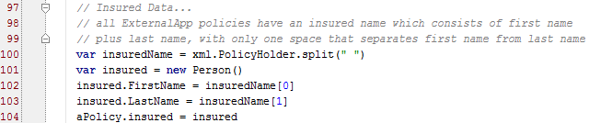
Mapping contact data
Policy
Location
Address
Policy
RiskUnit
Coverage
Vehicle
Building
Class
Code
Endorse-
ment
CovTerm
Notes:
Typically, every policy will have at least one contact associated to it, which is the person or company covered by the policy.
XML Notes
In the ExternalApp homeowners example, the insured's name is in the <PolicyHolder> XML element, which is always a string comprised of the first name, a space, and the last name. Because ClaimCenter stores first and last name as separate fields, the policy holder's name must be split into two separate strings. (For virtually every real PAS, you would not be able to make this type of assumption. Code that transforms an InsuredName value into a first and last name would need to be more robust to check for all the variations that a real PAS is likely to have.)
Policy Retrieval Integration - <number>

Slide 37
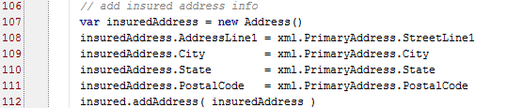
Mapping address data
Policy
Location
Address
Policy
RiskUnit
Coverage
Vehicle
Building
Class
Code
Endorse-
ment
CovTerm
Notes:
Typically, multiple objects in the policy graph (such as the insured) have an address. For each address, an Address object must be created, and objects referencing that address must be linked to it.
XML Notes
Lines 108 through 111 map information from the following elements in the XML:
<PASPolicy>
<PrimaryAddress>
<StreetLine1>...</StreetLine1>
<City>...</City>
<State>...</State>
<PostalCode>...</PostalCode>
...
</PrimaryAddress>
...
</PASPolicy>
Policy Retrieval Integration - <number>

Slide 38
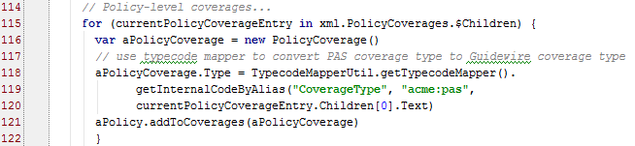
Mapping policy coverage data
Policy
Location
Address
Policy
RiskUnit
Coverage
Vehicle
Building
Class
Code
Endorse-
ment
CovTerm
Notes:
Policies have two types of coverages: policy-level coverages and risk unit coverages. For each policy-level coverage, a PolicyCoverage object must be created and added to the policy's Coverages array.
XML Notes
Line 116 begins a for loop that iterates across all the children on the <PolicyCoverages> element.
The children of <PolicyCoverages> are <Entry> elements, each of which has a child <CoverageName> element. For example, the following shows how two coverages would appear in the XML:
<PolicyCoverages>
<Entry>
<CoverageName>Homeowners Personal Liability</CoverageName>
</Entry>
<Entry>
<CoverageName>Homeowners Medical Payments</CoverageName>
</Entry>
</PolicyCoverages>
Consequently, the following Gosu expressions reference the following values:
"currentPolicyCoverageEntry" references the current <Entry> element.
"currentPolicyCoverageEntry.Children[0]" references the first child of the current <Entry> element (which is always a <CoverageName> element).
"currentPolicyCoverageEntry.Children[0].Text" references the value of the first child of the current <Entry> element (which is always the coverage's name).
Line 119 uses the typecode mapper utility to transform the code received from the PAS into a Guidewire typecode. Specifically, lines 120 to 121 mean "retrieve the Guidewire code from the CoverageType typelist that corresponds to the "acme:pas" code stored in the current <Entry> element's <CoverageName> child.
Policy Retrieval Integration - <number>

Slide 39
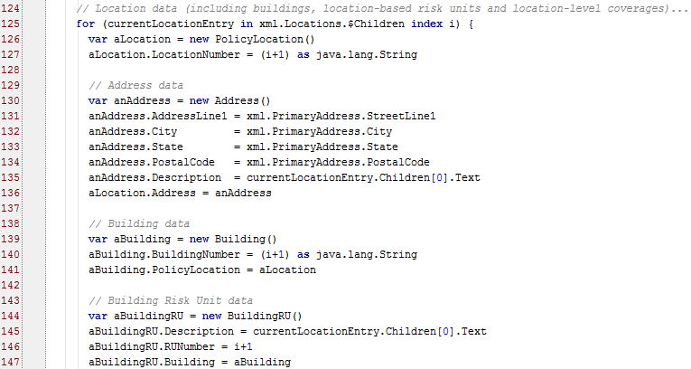
Mapping building data
Policy
Location
Address
Policy
RiskUnit
Coverage
Vehicle
Building
Class
Code
Endorse-
ment
CovTerm
Notes:
For homeowner's policies, the primary risk units are buildings. For each building on the policy, the following must be created: a Building, a correspodning BuildingRU, and a corresponding PolicyLocation.
XML Notes
Every location should have a location number. Consequently, line 127 defines an index for the loop (as i) and line 129 sets the location number for the location using i. (Loop indexes start at 0, but location numbers should start at the more user-friendly 1. Also, indexes are numeric, but LocationNumber values are strings. Thus, the index is incremented by 1 and then cast as a String.)
In the XML, the <Locations> element has a series of 0 to many <Entry> elements. The first child of each <Entry> element is a <Description> element. For example:
<Locations>
<Entry>
<Description>covered house</Description>
...
</Entry>
<Entry>
<Description>shed</Description>
...
</Entry>
</Locations>
Consequently, the Gosu expression "currentLocationEntry.Children[0].Text" on line 140 references the text in the first child of the current <Entry> element (which will always be the text of the <Description> element).
Policy Retrieval Integration - <number>

Slide 40
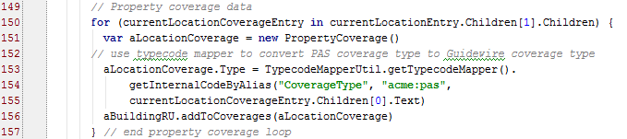
Mapping building coverage data
Policy
Location
Address
Policy
RiskUnit
Coverage
Vehicle
Building
Class
Code
Endorse-
ment
CovTerm
Notes:
Policies have two types of coverages: policy-level coverages and risk unit coverages. For each risk unit coverage, a Coverage object of the appropriate subtype (such as PropertyCoverage) must be created and added to the risk unit's Coverages array.
XML Notes
Every <Entry> element in the <Locations> element has two children:
A <Description> element
A <LocationCoverages> element, that has further children
The Gosu expression "currentLocationEntry.Children[1].Children" (on line 151) references the children of the <LocationsCoverages> element (Children[1].Children) for the current <Entry> element (currentLocationEntry).
Line 154 uses the typecode mapper utility to transform the code received from the PAS into a Guidewire typecode. Specifically, lines 155 to 156 mean "retrieve the Guidewire code from the CoverageType typelist that corresponds to the "acme:pas" code stored in the current <Entry> element's <CoverageName> child.
Policy Retrieval Integration - <number>

Slide 41
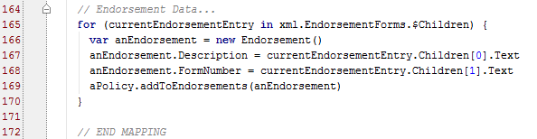
Mapping endorsement data
Policy
Location
Address
Policy
RiskUnit
Coverage
Vehicle
Building
Class
Code
Endorse-
ment
CovTerm
Notes:
Endorsements are relatively straight-forward. They typically contain simple text values and are typically not linked to other objects in the policy graph. (Typically, the policy identifies only which endorsements are part of a given policy. The content of those endorsements is not captured on each policy individually.)
XML Notes
In the XML, the <EndorsementForms> element has a series of 0 to many <Entry> elements. Each <Entry> element has two children: <Description> and <FormNumber>. For example:
<EndorsementForms>
<Entry>
<Description>Mold Exclusions</Description>
<FormNumber>MEX-111</FormNumber>
</Entry>
...
</EndorsementForms>
Consequently, the Gosu expressions on the following lines reference the following values:
"currentEndorsementEntry.Children[0].Text" on line 180 references the text in the first child of the current <Entry> element (which will always be the text of the <Description> element).
"currentEndorsementEntry.Children[1].Text" on line 181 references the text in the second child of the current <Entry> element (which will always be the text of the <FormNumber> element).
Policy Retrieval Integration - <number>

Slide 42
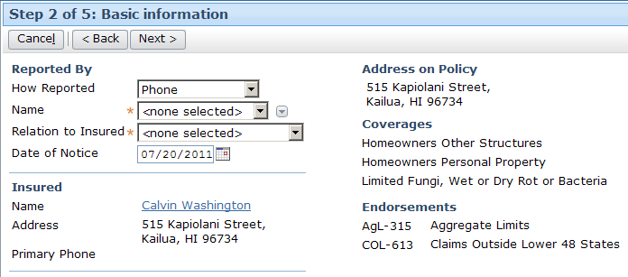
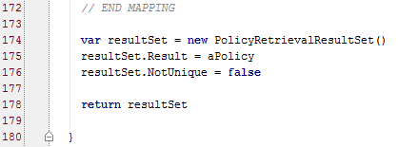
Returning resulting policy
Policy
Notes:
The policy must be returned as part of a PolicyRetrievalResultSet object. The object has two fields:
The Result field is a reference to the policy that has been built by the method.
The NotUnique field indicates where the results are unique or not unique. The field must be set manually. Although it is somewhat counter-intuitive, a value of false indicates success. (It is "not true that the policy is not unique". Or in simpler terms, "the policy is unique".)
Policy Retrieval Integration - <number>

Slide 43
Lesson objectives
You should now be able to:
  List the high-level steps of policy retrieval
  List the primary entities in the policy graph
  Identify the typelists in the Line of Business model that policy retrieval must map to
  Implement a basic policy retrieval integration point
Notes:
Policy Retrieval Integration - <number>

Slide 44
Review questions
If a PAS has ten policies, and ClaimCenter creates three claims from each policy, how many Policy instances exist in ClaimCenter?
What is the difference between:
  A policy coverage and a risk unit coverage?
  A coverage and a coverage term?
Which two entities in the policy graph have "types" that must be found in typelists in the ClaimCenter LOB model?
Notes:
Policy Retrieval Integration - <number>
Answers
1. 30. (Every claim has a unique copy of the policy it uses.)
2. a) A policy coverage is a coverage that extends across the entire policy and usually protects the policy holder). A risk unit coverage is a coverage that applies only to a specific risk unit (such as a vehicle, building, or trip).
b) A coverage is a protection from a specific risk. A coverage term further defines or limits a coverage (typically through deductibles and limits).
3. PolicyType and CoverageType

Slide 45
Notices
Copyright © 2001-2013 Guidewire Software, Inc. All rights reserved.
Guidewire, Guidewire Software, Guidewire ClaimCenter, Guidewire PolicyCenter, Guidewire BillingCenter, Guidewire Reinsurance Management, Guidewire ContactManager, Guidewire Vendor Data Management, Guidewire Client Data Management, Guidewire Rating Management, Guidewire InsuranceSuite, Guidewire ContactCenter, Guidewire Studio, Guidewire Product Designer, Guidewire Live, Guidewire DataHub, Guidewire InfoCenter, Guidewire Standard Reporting, Guidewire ExampleCenter, Gosu, Deliver Insurance Your Way, and the Guidewire logo are trademarks, service marks, or registered trademarks of Guidewire Software, Inc. in the United States and/or other countries.
Guidewire products are protected by one or more United States patents.
Notes:
Notices - <number>

